Slide 1


SMART INDIA HACKATHON 2025
Problem Statement ID – SIH25072
Problem Statement Title- Design and Implementation of Solar-Powered Dewatering in Mining Operations.
Theme- Renewable/Sustainable Energy
PS Category- Hardware
Team ID- 67505
Team Name – Solar Squad

Slide 2

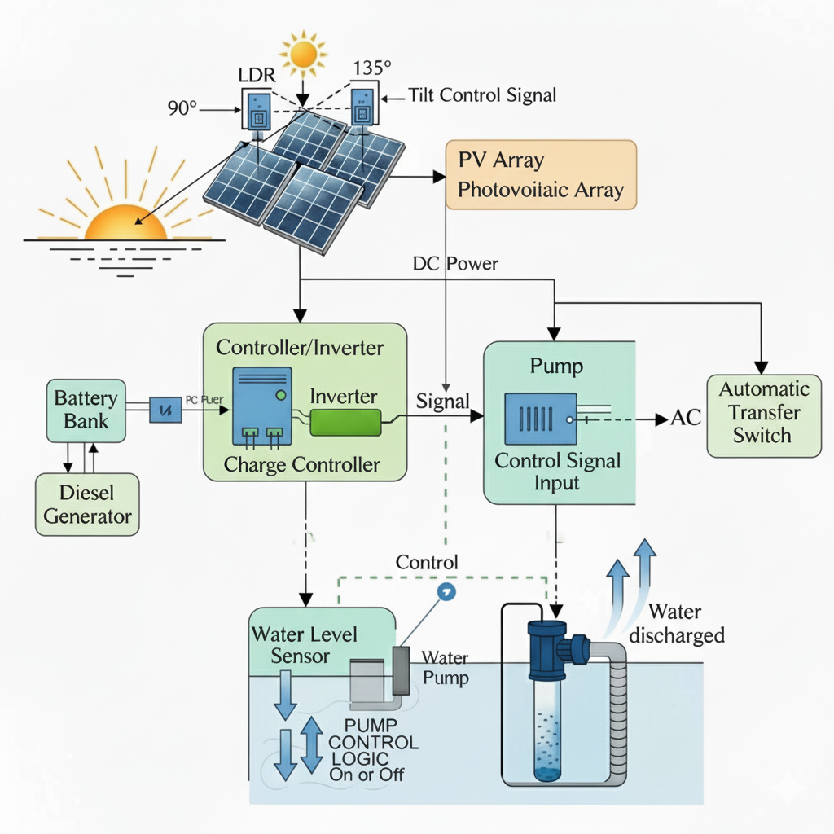
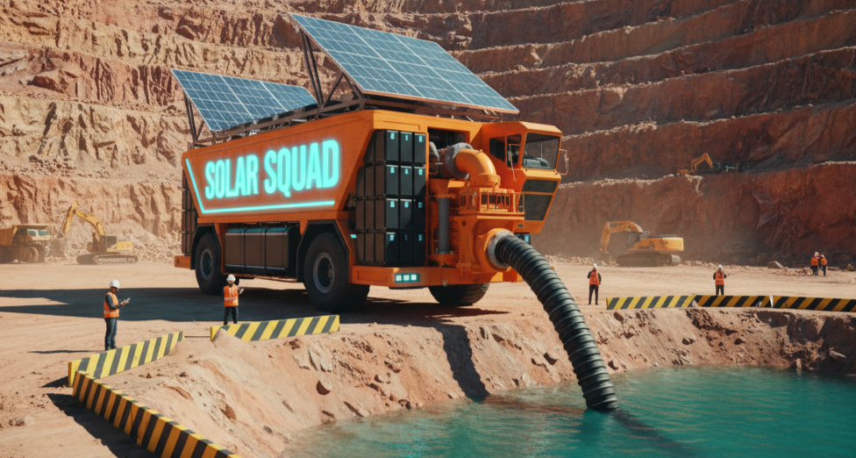
IDEA TITLE
Service-based model with vehicle-mounted solar-powered dewatering units.
Pre-installed systems on vehicles for quick deployment and plug-and-play setup.
Scalable solution – number of vehicles sent depends on site water requirements.
No upfront infrastructure needed, reducing downtime and complexity.
OPEX-based approach – pay for service, not equipment.
Eco-friendly & reliable alternative to diesel and grid-powered pumps.

Slide 3
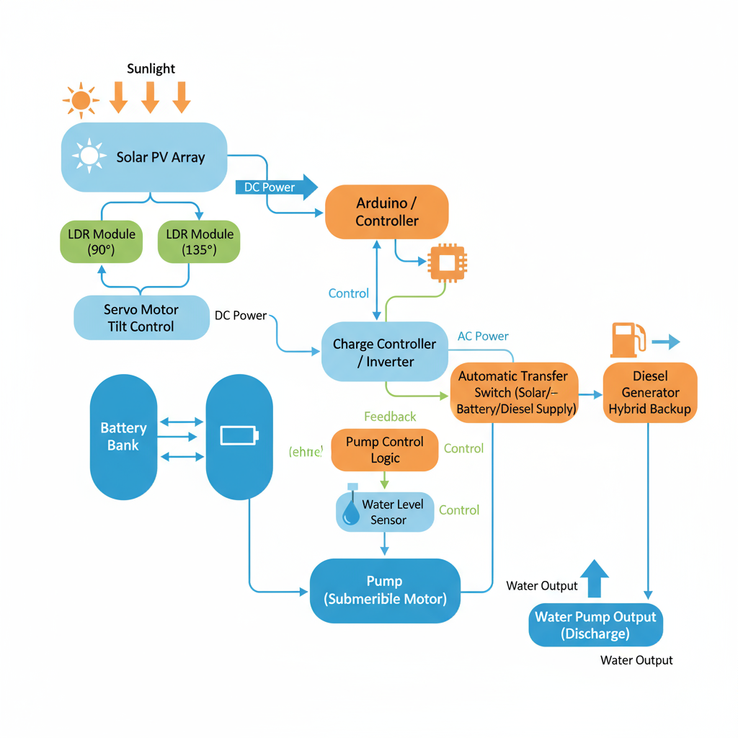
TECHNICAL APPROACH
Solar PV generates power. Tilt is optimized by LDR and servo.
Charge controller/inverter manages solar output battery bank stores excess energy.
Diesel backup runs if solar/battery are insufficient.
Automatic transfer switch selects power source.
Water level sensor controls pump logic.
Submersible pump discharges water as needed

Slide 4
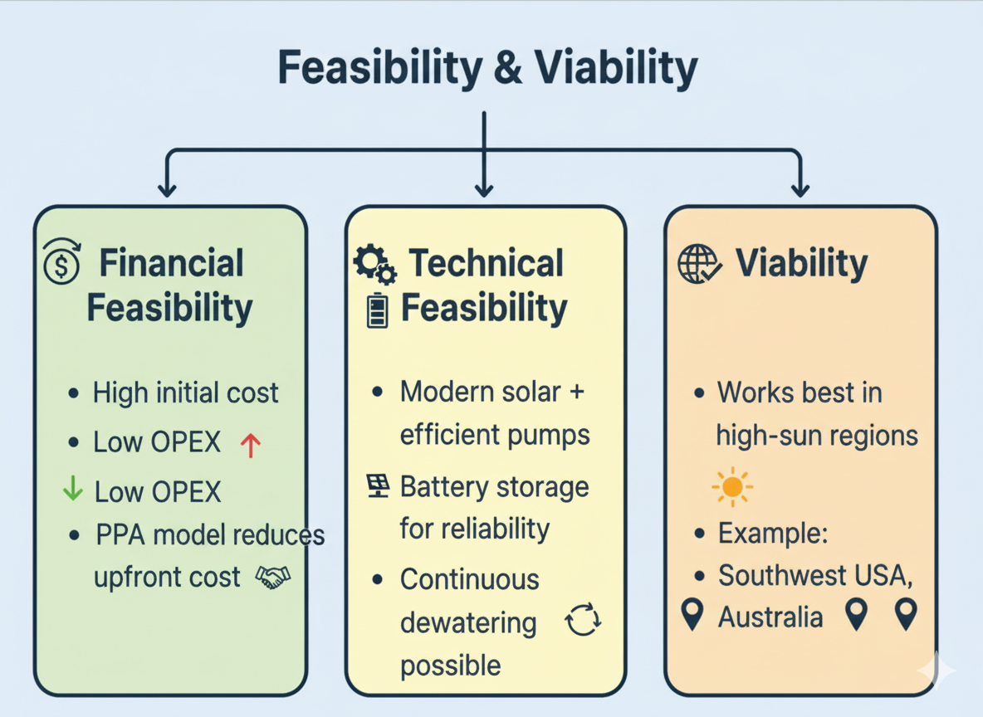
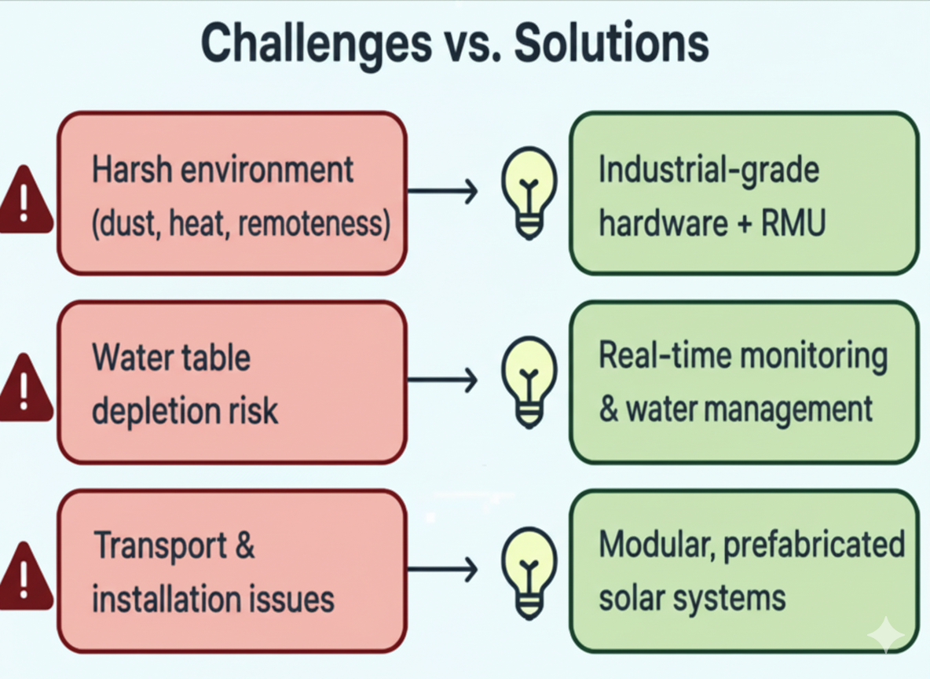
FEASIBILITY AND VIABILITY

Slide 5
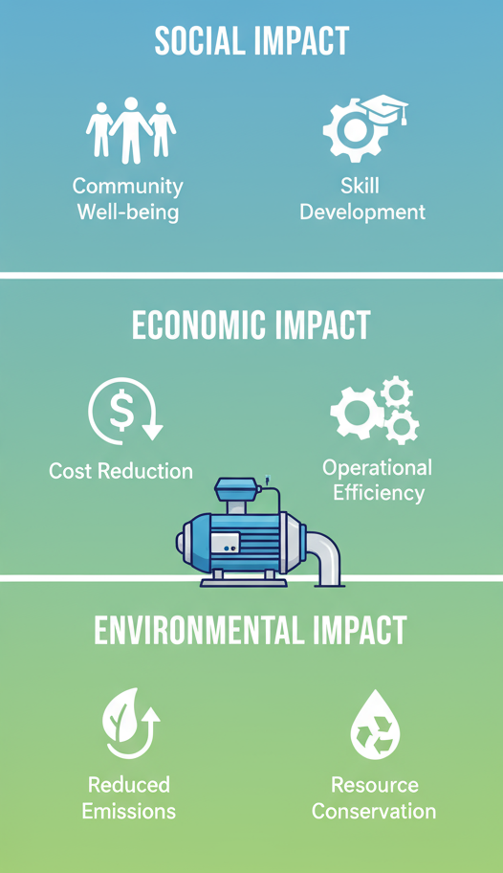
IMPACT AND BENEFITS
1. Social Impact & Benefits:
Community Well-being – Lower air and noise pollution from reduced diesel use.
Skill Development – Training workers in solar + smart-pump systems builds technical capacity.
2. Economic Impact & Benefits
Cost Reduction – Saves on diesel fuel and expensive transport to remote mines.
Operational Efficiency – Less downtime, lower maintenance, and higher productivity.
3. Environmental Impact & Benefits
Reduced Emissions – Up to 95–97% cut in CO₂ and NOx compared to diesel pumps.
Resource Conservation – Eliminates diesel logistics, lowering ecological footprint.

Slide 6
RESEARCH AND REFERENCES
Solar water pumping system for water mining applications: https://www.sciencedirect.com/science/article/abs/pii/S0959652614010890
The use of solar energy in the copper mining processes (2021): https://www.sciencedirect.com/science/article/pii/S2666790821002196
Utilization of solar and wind power-generation systems in the mining industry: recent trends and future prospects (2024): https://jsm.gig.eu/cgi/viewcontent.cgi?article=1431&context=journal-of-sustainable-mining
Innovative Tailings Dewatering Advancements in Mining: https://www.wsp.com/en-gl/insights/innovation-in-tailings-dewatering
Estimating dewatering in an underground mine by using a 3D groundwater model (2020): https://journals.plos.org/plosone/article?id=10.1371/journal.pone.0239682

